Slide 1
CP23 - SetDose - Optical recognition software for liquid medication dosing
COMP3888_T15_06_Group4
Xiaolin Zhao, 480406662, xzha3077
Zhiran Bai, 480446772, zbai6612
An Yan, 480158532, ayan0137
Zhiyang Zhang, 470482647, zzha6434
Hurui Yang, 480170936, hyan5496
Client name: Rebekah Moles, Philip Boughton, Andrea Gonzalez
Tutor name: Regina Wang

Slide 2
A brief summary
Introduction ----Alex
Timeline ----Alex
Stakeholder ----Ice
User stories ----Robert
System design ----Warren
Testing ----An
Demonstration video ----Robert, An and Warren
Roles and Group process ----Ice

Slide 3
Deep Learning and Computer Vision In Healthcare
Introduction
Deep learning benefits computer vision in making computers to understand visual data
By being fed of raw data, computer could develop its own image recognition with high accuracy with deep learning.
Several studies have demonstrated promising results in complex medical diagnostics tasks spanning dermatology, radiology, or pathology.
The convolutional neural networks (CNN) have achieved human-level performance in objects classification tasks.
Top 10 applications
Tumor Detection. (Especially Brain tumors)
Medical Imaging.
Cancer Detection.
Medical Training.
Combating Covid-19.
Health Monitoring.
Machine-assisted Diagnosis.
Timely Detection Of Disease.
Remote patient monitoring
Lean management

Slide 4
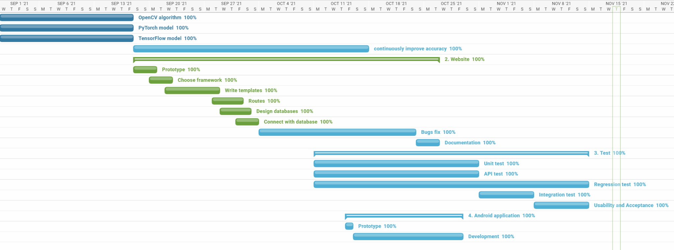
Project management

Slide 5
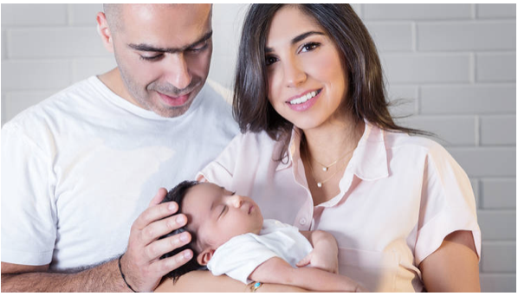
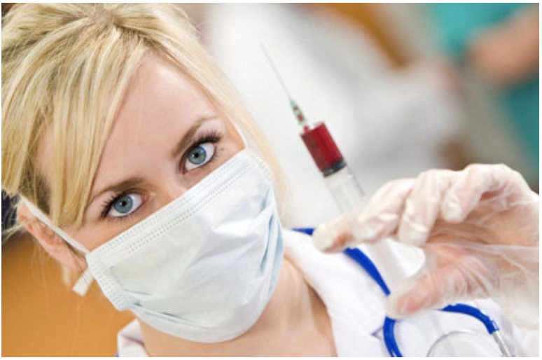
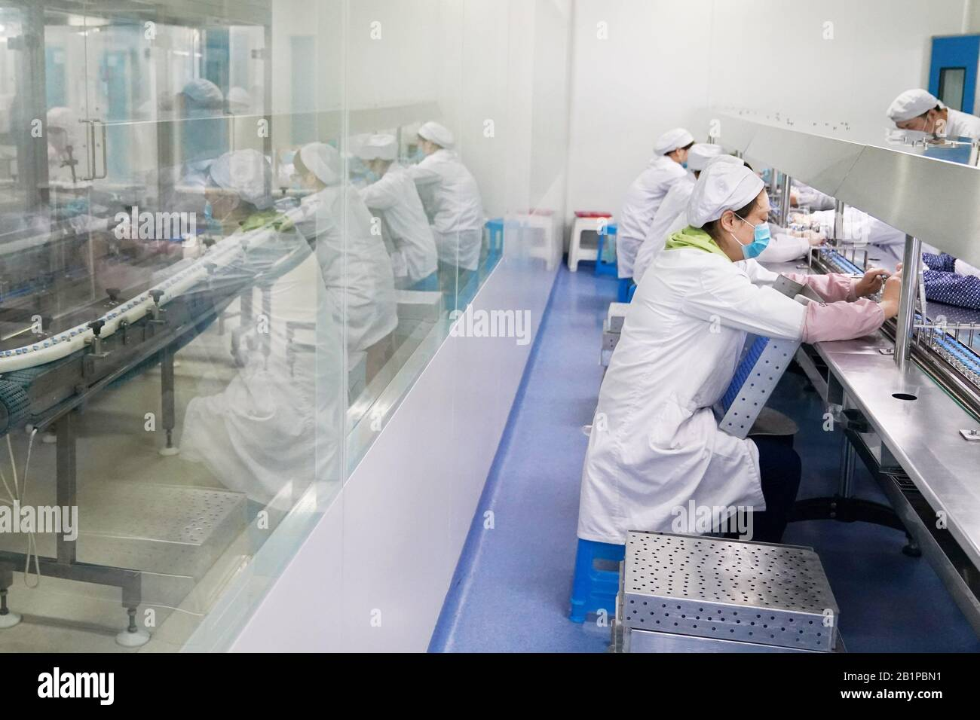
Stakeholders
Pharmaceutical enterprises
Family
Medical stuff

Slide 6
Functional feature
User story deployed
Non-functional feature
Website
Recognize the volume
Recognize the medicine type
Have a account system
Allow users to manage their syringe record history / information
Enable administrator account to inspect/manage users’ accounts.
Android app
Usability
low learning cost on website and app
easy to manage personal profile/History
Performance
threshold of 5% error rate
less than 2 seconds

Slide 7
system design
Three algorithms for estimation
A server and several APIs
Android App

Slide 8



Machine learning package

Slide 9
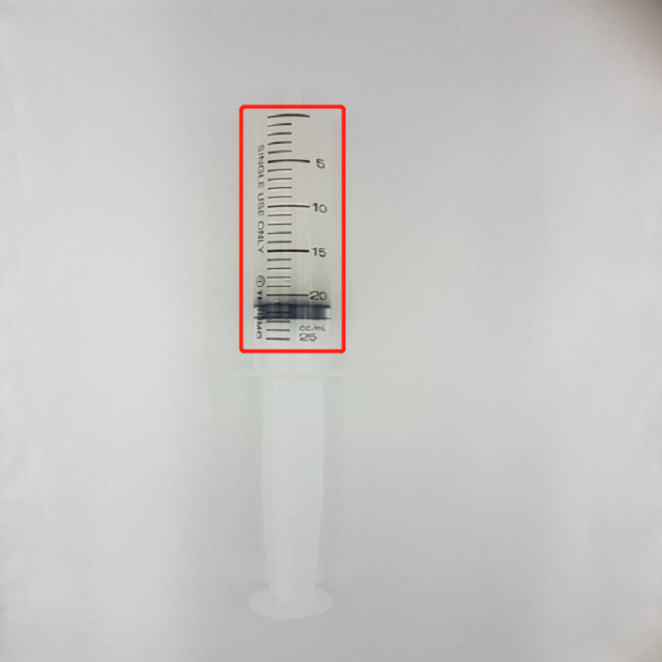
Volume Recognition
(CV part)
Convert to Gary
Canny -> edge detection
Locate the piston
Calculate the volume

Slide 10
Color Recognition
RGB to HSV
RGB value of the pixel

Slide 11
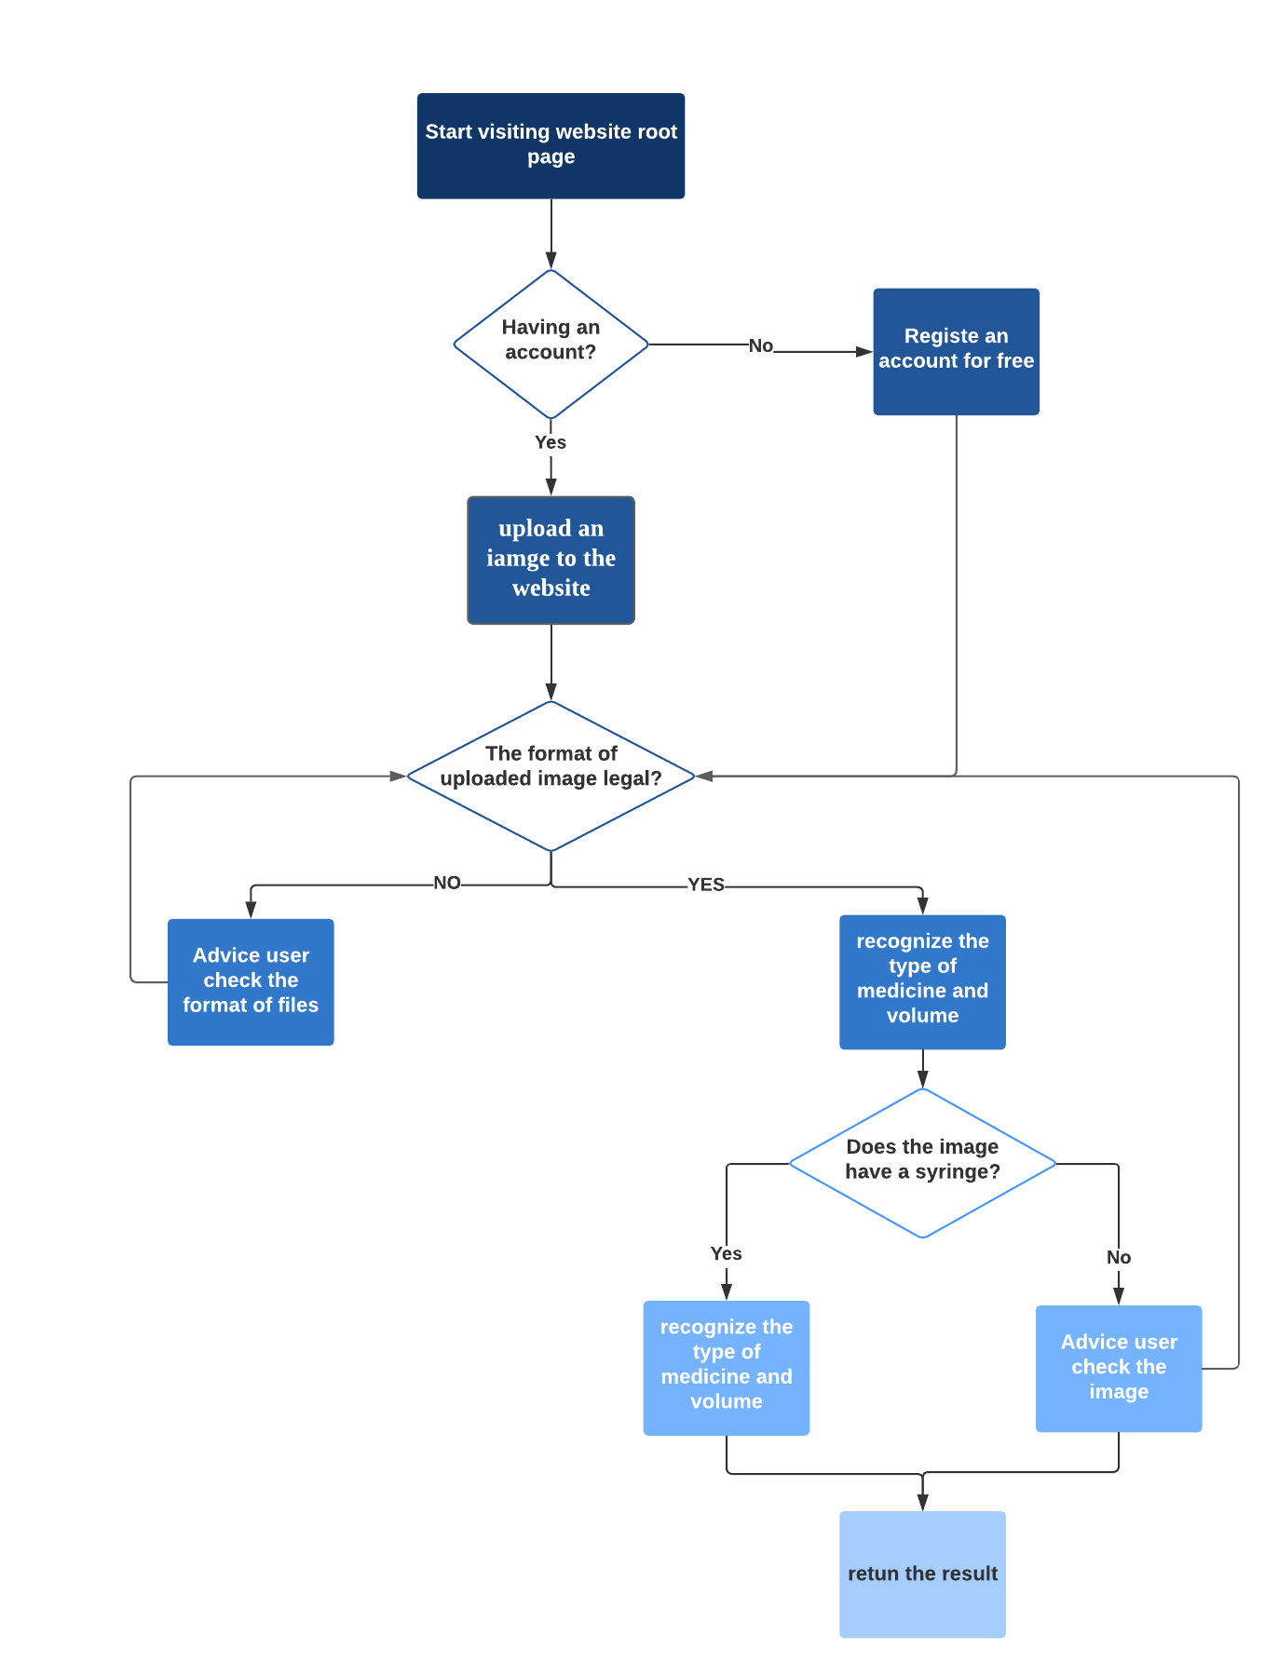
Workflow(web)
User system
Recognition
History review

Slide 12
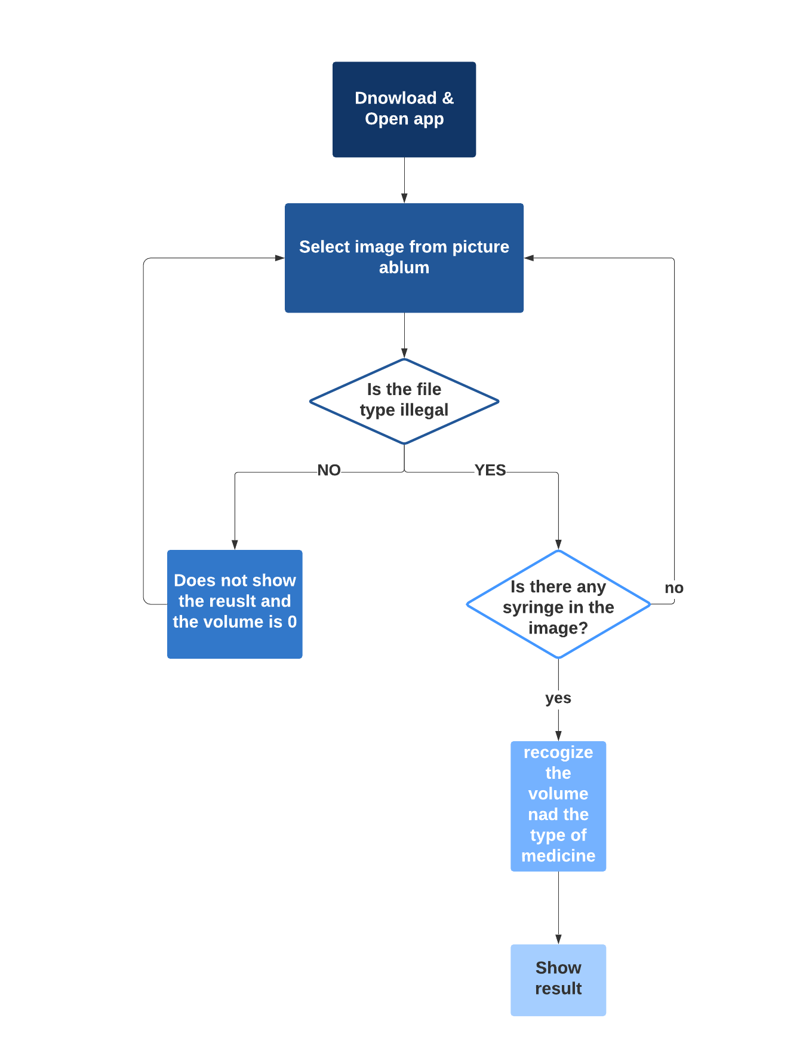
Workflow(Android)
Offline version
Simple & easy

Slide 13
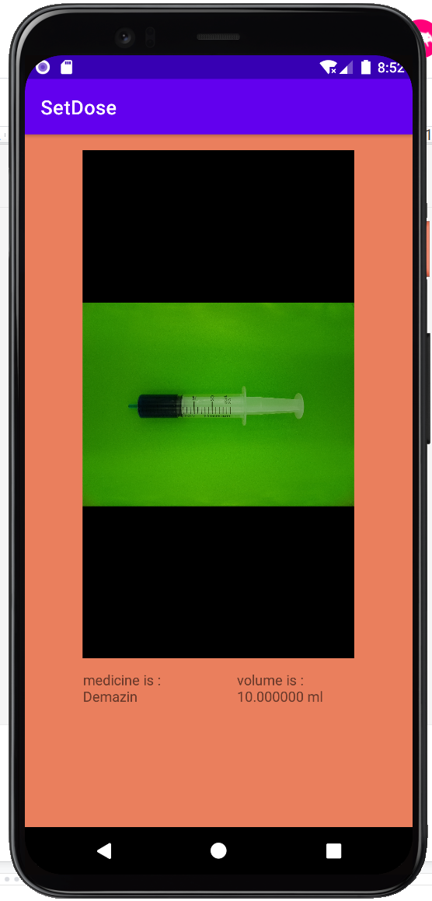
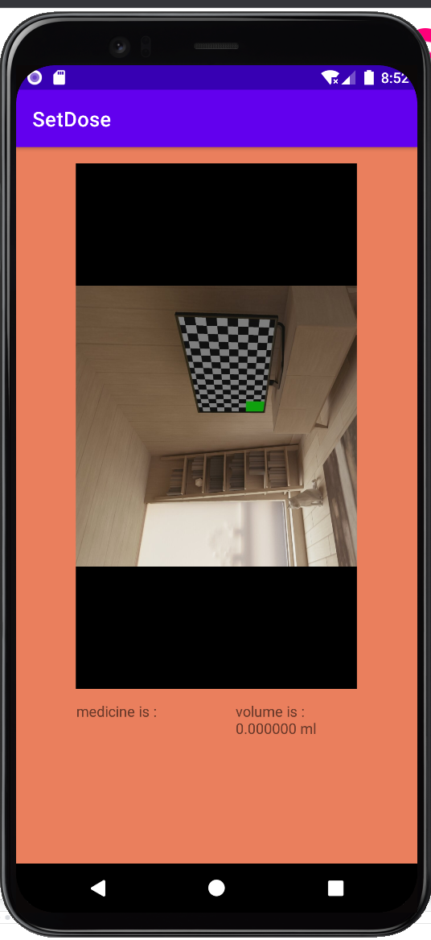
Android app
Api 26
Test device: Pixel 4
Java version:1.8

Slide 14
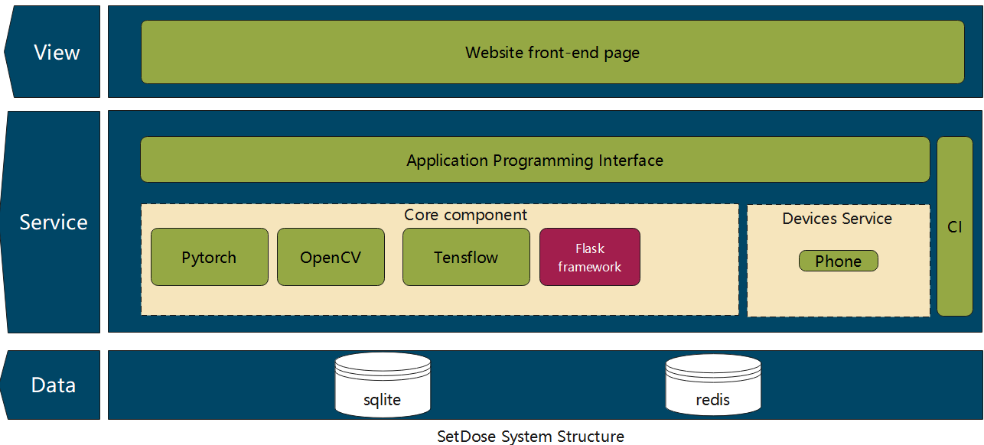
Overall system architecture

Slide 15
Technical constraints
web front end page limitation
Opencv sdk on Android app
Cloud server deployment

Slide 16
Testing plans
Test for machine learning model (The first sprint)
Unit test for web application (Oct 11th - Oct 31th)
Regression test for website (The whole process of project)
API test for website (Oct 11th - Oct 31th)
Integration test (Nov 1st - Nov 7th)
Usability and acceptance test (Nov 8th - Nov 14th)

Slide 17
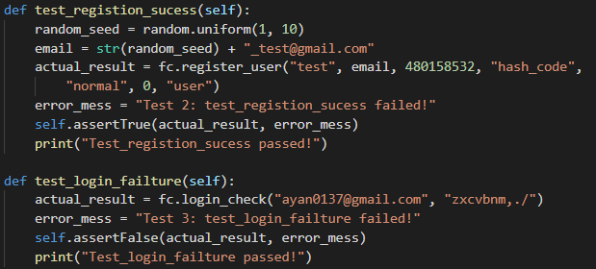
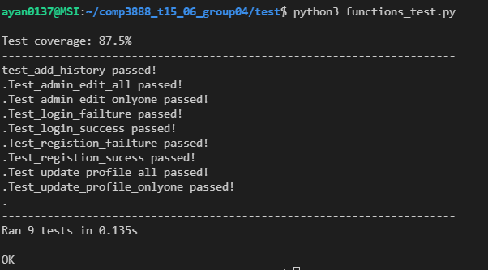
System testing - Unit test
Use Unittest in python as automated testing tool
Use relative boundary analysis as testing techniques
Mainly test functions like register, login and update profile.
Test coverage: 87.5%

Slide 18
System testing - Regression test
We use selenium to automatically test our overall project with all the components combined together.
This test is required to run regressively every time when a new change is made to ensure the change is not making new errors and previous functions is still working well.

Slide 19

System testing - Regression test

Slide 20
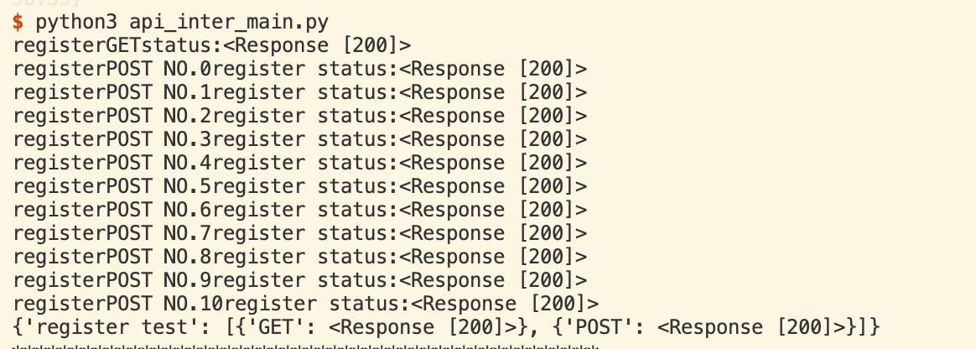
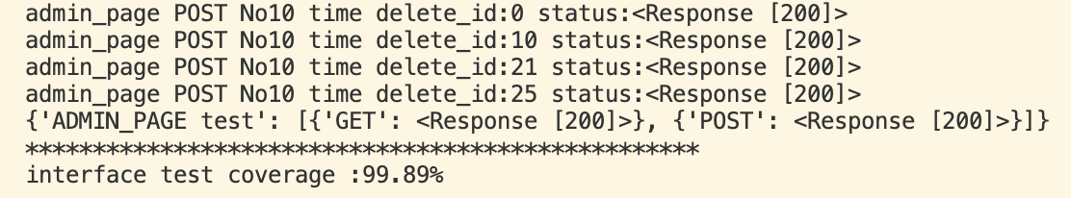
API testing
Built with requests
All 7 interfaces:
Such as register, login, history…...
Stress testing:
Multi-user
Multi-request
Test coverage: Nearly 100%

Slide 21
User acceptance testing
Act as users or invite people outside of the team as users
Consider 3 situations: Normal, Boundary and Abnormal
Some examples of acceptance test:
whether the user can get correct medicine volume with 5% error rate
whether software return result within at most 2 seconds
whether software is easy for users to use
Normal: Invite people with general Internet experience, like other classmates
Boundary: Invite people with a little Internet experience, like our parents
Abnormal: Invite people with no Internet experience, like the elder

Slide 22
Project discipline knowledge
Computer Science and advanced computing
Python, Java
Computer vision -- opencv
Machine learning packages -- tensorflow, pytorch
Python Web framework -- Flask
Database management system -- SQLite
Testing -- requests,unittest, selenium.....
Android framework -- java, google.android

Slide 23
Demonstration
Web application
Simple Android app

Slide 24
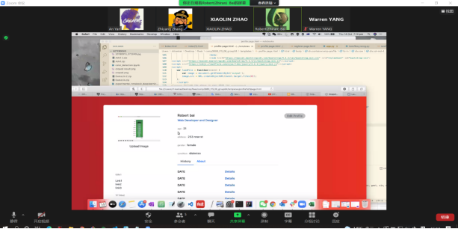
Collaboration and teamwork
parallel programming on Zoom meeting
code review by using Bitbucket
one or two group meeting each week
progress sharing on Slack

Slide 25
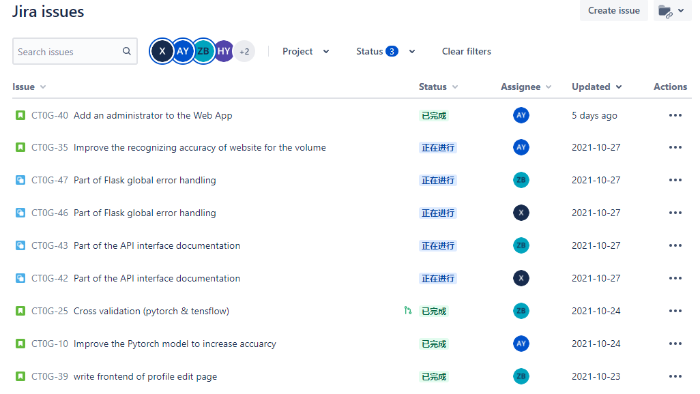
“Issues” tracking
Use of tool
Bitbucket(code view)
Slack(communication)
Zoom(meeting)
Jira Issue(progress check)

Slide 26
Team Role
Reflection on key improvements
Xiaolin: Manager and Tracker
An Yan: Customer
Hurui Yang: Headprogramer
Zhiran Bai: Doomsayer
Zhiyang Zhang:Tester
Higher work efficiency
More frequent teammate communication
More reasonable work arrangement

Slide 27
Thanks for listening!
Q & A time

